Slide 1







EVStore: Storage and Caching Capabilities for Scaling Embedding Tables in Deep Recommendation Systems
Daniar H. Kurniawan, Ruipu Wang,
Kahfi Zulkifli, Fandi Wiranata,
John Bent, Ymir Vigfusson, Haryadi S. Gunawi

Slide 2







VANC UVER

Slide 3





Deep Recommendation Systems (DRS)
Usage: Personalized advertisements, movies, news, product recommendation, etc.
Impact:
30% 40% 60% 75%
What’s inside?
Similar videos are suddenly being recommended to me
???
I watch
Database
ML Models
Embedding Table

Slide 4




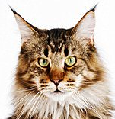

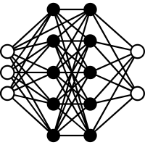




DRS model deployment
Similar objects will appear closer in the vector space
1. Core Model
2. Embedding
RAM
Tens of TB and growing!
Kitten
Cat
Dog
Apple
0.1
0.2
…
- 0.1
0.2
0.2
…
- 0.1
0.3
0.3
…
- 0.1
- 0.3
- 0.3
…
0.3
Low latency
Poor scalability
Very expensive
Embedding Vector (EV)
DRS is up against a scaling wall!
Embedding-lookup = ~40% of inference latency

Slide 5


Existing solution:
Ours:
RAM
RAM
EVStore: A Three-Layer
Caching System
Specialized Storage HW
L1
+
L2
+
L3
Off-load the embedding table to specialized storage
Commodity SSD
but...
94%
Lighter memory
23%
Faster inference
4x
Model collocation
Require HW Modification
Complex to use

Slide 6


EVStore Overview
Existing algorithms
(e.g., LRU, Clock, LIRS, LeCAR)
are not effective!
Let’s cache the smaller precision!
Let’s enable approximation!
EVCache: Optimized for multi-table lookups
EVMix: mixed-precision caching
EVProx: Approximate Embedding
L1
L1
L2
L1
L2
L3

Slide 7
The Story of EVStore
Goal: Scalable and performant DRS deployment on commodity backend
Design Principles
Simple policies
Modular for easy integration
Limitation: Stale cache problem flush the cache
EVStore Approach/Techniques
+ EVCache : Groupability-aware caching
+ EVMix : Mix-precision caching
+ EVProx : Embedding approximation
L1
L1
L2
L1
L2
L3
94%
Lighter memory
23%
Faster inference
4x
Model collocation

Slide 8
Background & Motivation
EVStore Overview
EVStore: Design
EVCache: Groupability-aware caching
EVMix: Mixed-precision caching
EVProx: Embedding approximation
EVStore Evaluation
Overhead
Summary

Slide 9


EVStore₁ : Groupability-aware caching (EVCache)
EVCache :
Extract groupability relationships between items to improve perfect-hit
L1
lookup(A₁, B₄, C₆, . . Z₉)
All hit = PERFECT hit
Recency | Frequency | Groupability
Other algorithms
EVCache (ours)
Optimized to improve the perfect hit rate

Slide 10
Groupability Scoring (1/3)
Cache State
(prior lookup)
Cache State
(after lookup)
A1
→ 0
Newly inserted
The 1st Lookup
B1
→ 0
Newly inserted
A1
B1
C1
D1
E1
C1
→ 0
Newly inserted
D1
→ 0
EMPTY
Newly inserted
#hit = 0
E1
→ 0
Newly inserted

Slide 11
Groupability Scoring (2/3)
Cache State
(prior lookup)
Cache State
(after lookup)
A1
→ 0
A1
→ 3
Updated
The 2nd Lookup
→ 0
B1
→ 3
B1
Updated
A1
B1
C1
D2
E2
C1
→ 0
C1
→ 3
Updated
D1
→ 0
D1
→ 0
#hit = 3
E1
→ 0
E1
→ 0
D2
→ 3
Newly inserted
E2
→ 3
Newly inserted

Slide 12
Groupability Scoring (3/3)
Cache State
(prior lookup)
Cache State
(after lookup)
A1
→ 3
A1
→ 4
Updated
The 3rd Lookup
B1
→ 3
B1
→ 4
Updated
A1
B1
C1
D2
E3
C1
→ 3
C1
→ 4
Updated
D1
→ 0
D1
→ 0
#hit = 4
E1
→ 0
E1
→ 0
D2
→ 3
D2
→ 4
Updated
E2
→ 3
E2
→ 3
E3
→ 4
Newly inserted

Slide 13
EVCache Eviction
Prior Eviction
After Eviction
A1
→ 4
Eviction algorithm:
Check Groupability
Check Recency
A1
→ 4
B1
→ 4
B1
→ 4
C1
→ 4
C1
→ 4
→ 0
Evicted!
D1
D1
→ 0
Eviction candidates
E1
→ 0
E1
→ 0
Least recent!
D1
→ 0
D2
→ 4
D2
→ 4
→ 3
E1
→ 0
→ 3
E2
E2
E3
→ 4
E3
→ 4

Slide 14
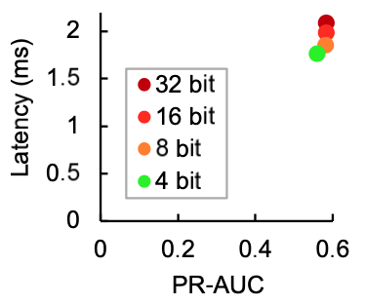

EVStore₂ : Mixed-precision caching (EVMix)
EVCache :
Extract groupability relationships between items to improve perfect-hit
L1
+
EVMix :
Split the cache into two layers, with each layer storing different precision
L1
L2
Lower precision = faster inference latency

Slide 15
EVStore₂ : Mixed-precision caching (EVMix)
EVCache :
Extract groupability relationships between items to improve perfect-hit
L1
+
EVMix :
Split the cache into two layers, with each layer storing different precision
L1
L2
Lower precision
Cache more
key-value pairs
The more data being cached, the higher perfect-hit

Slide 16
EVStore₂ : Mixed-precision caching (EVMix)
EVCache :
Extract groupability relationships between items to improve perfect-hit
L1
+
EVMix :
Split the cache into two layers, with each layer storing different precision
L1
L2
Higher precision
Lower precision
Higher accuracy
Faster latency
Enable accuracy vs latency tradeoff

Slide 17
EVStore₃ : Embedding value approximation (EVProx)
EVCache :
Extract groupability relationships between items to improve perfect-hit
L1
+
EVMix :
Split the cache into two layers, with each layer storing different precision
L1
L2
+
EVProx :
Enable key-to-key caching to find an approximately similar embedding value
L1
L2
L3
Surrogate keys
preprocessing :
Run similarity analysis
Analyze key’s popularity
Euclidian and Cosine dist.
Surrogate key → The most popular key out of N-most similar keys

Slide 18

The Effectiveness of EVProx
The tail is shifted
from p80 to p98
EVProx only uses 4% of the cache size
End-to-end Inference Latency (ms)
“Small but powerful”

Slide 19





EVStore: Data Life Cycle
Goal :
No duplicate items
Minimize data trashing
L1
Reduce data precision
L2
Only store the key
L3

Slide 20
Background & Motivation
EVStore Overview
EVStore Design
EVCache: Groupability-aware caching
EVMix: Mixed-precision caching
EVProx: Embedding approximation
EVStore Evaluation
Overhead
Summary

Slide 21


EVStore Stack and Evaluation Setup
batch size = 1
Avazu, Criteo Kaggle, Criteo Terabyte
User
Online Inference Workloads
1. Inference latency
DL Engine
PyTorch
Metrics
2. Accuracy
EVCache
Metric
3. Perfect-hit rate
EVStore
EVMix
EVProx
vs. State-of-the-art
Memory (CPU-DRAM)
Cached Embedding
ClockPro
LRU
LFU
CAR
LeCAR
LIRS
DLIRS
Clock
SSDs
Raw Embedding Tables
CACHEUS
ARC
ClockLIRS

Slide 22
EVCache vs State-of-the-art
EVCache variants!
EVCache variants get up to 10% higher perfect hit rate!

Slide 23
Perfect-hit vs Individual-hit

Slide 24
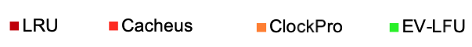
EVCache on Various Workloads
(ours)
vs. State-of-the-art
Fundamental
ML-based
Adaptive
LRU
CACHEUS
ClockPro
LFU
LeCAR
ClockLIRS
Clock
CAR
ARC
LIRS
DLIRS
EV-LFU shows steeper benefit as the number of EV tables grows!
EV-LFU outperform others on various datasets!

Slide 25
Perfect-hit rate on various cache sizes
A gap!
35%

Slide 26
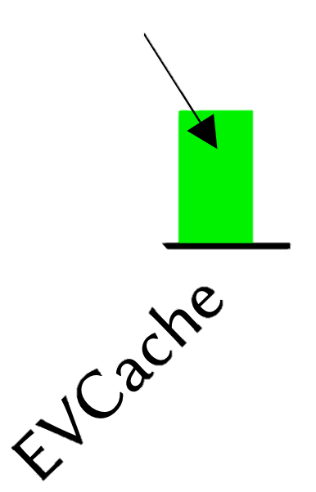
Where to put the caching layer?
External caching layer is NOT effective!
An optimum place to deploy EVCache is in the DLRM!

Slide 27
How to implement EVMix?
20% faster
Goal: Find the most performant Implementation of EVMix layers
Setup
Baseline: Python-based caching layer within the DLRM
Precision: 32bit

Slide 28

EVStore Orthogonal Evaluation
SLA : Inference Latency < 2 ms
Accuracy drop < 0.2%
Memory Usage!
Meta’s DLRM → baseline
EVCache_Py + LRU
EVCache_Py + EVLFU
EVCache_Cpp + EVLFU (32bit)
EVCache_Cpp + EVLFU (16bit)
EVCache_Cpp + EVMix (8bit + 4bit)
EVStore (EVCache + EVMix + EVProx)
Fully optimized EVStore reduces the memory usage by up to 94%

Slide 29
Collocating Multiple DRS
1 DRS model
4 DRS models

Slide 30
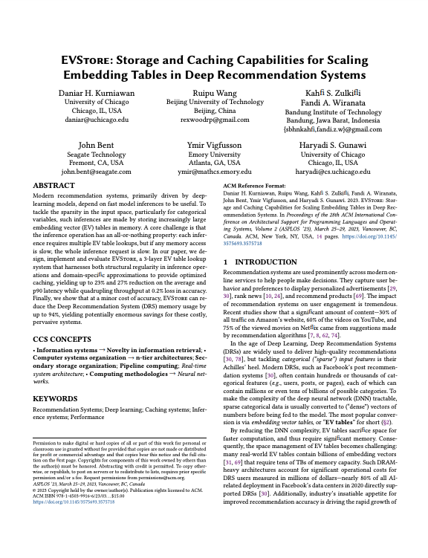
More in the Paper!
The importance of perfect hits
EVCache variants implementation
EVMix’s bit-coding optimization
More evaluation results
Trade-off between latency and accuracy
. . .

Slide 31



EVStore Overhead
Memory
No duplicate value
The embedding value is stored as it is
Storing groupability-score Negligible overhead (<1%)
Computation
Offline overhead mapping surrogate keys
Online overhead (negligible)
Converting low precision to full precision
Managing the cache eviction
Decoding stream of data from C++ to Python side
Storage (SSD)
Storing multiple precisions of the same value 2x Overhead

Slide 32
EVStore Summary
Storage and Caching Capabilities for Scaling Embedding Tables in Deep Recommendation System
EVCache: groupability-aware caching
EVMix: mixed-precision caching
EVProx: embedding value approximation
L1
+
L2
+
L3
94%
Lighter memory
23%
Faster inference
4x
Model collocation
EVStore code: https://github.com/ucare-uchicago/ev-store-dlrm

Slide 33
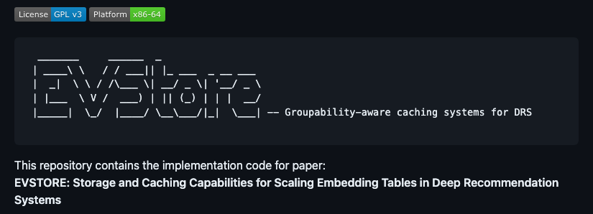




Thank you!
I’m on the job market. <daniar@uchicago.edu>

